Slide 1
Anomaly detection in graphs - past, present and future.
Leman Akoglu CMU
Mary McGlohon Google
Christos Faloutsos CMU

Slide 2
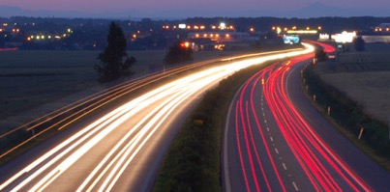
Roadmap
Introduction – Motivation
Past
Present
Future

Slide 3
Roadmap
Introduction – Motivation
Past
Present
Future
Q1) definition?
Q2) automation?
Q3) next steps?

Slide 4
Future – parting thoughts
Q1) Definition of anomaly?
A) “… strange/remote/unlikely, wrt our biases/priors”
Q2) can we automate it?
A) no, but: look for better models/biases/priors
Q3) next steps?
A) cross-disciplinarity -> new+better models

Slide 5
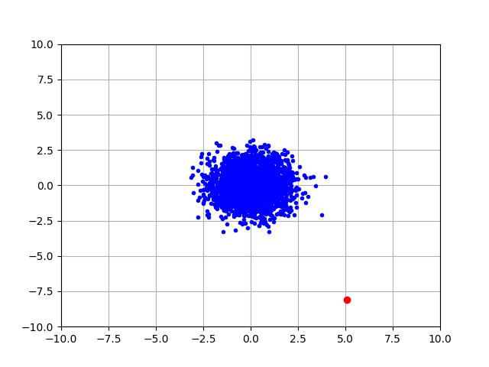
Q1) definition
‘deviation from the common rule’
https://www.merriam-webster.com/dictionary/anomaly

Slide 6
Q1) definition
‘deviation from the common rule’
https://www.merriam-webster.com/dictionary/anomaly
But: Who spots the rules?

Slide 7
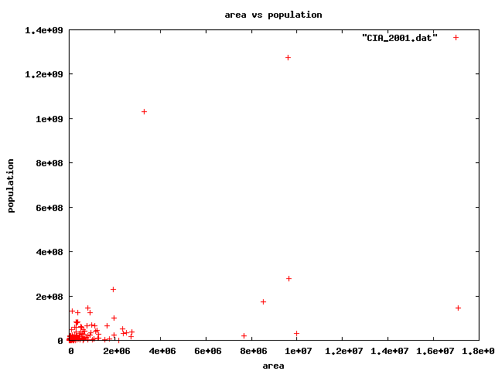
Q1: rules?

Slide 8
Q1: rules?

Slide 9
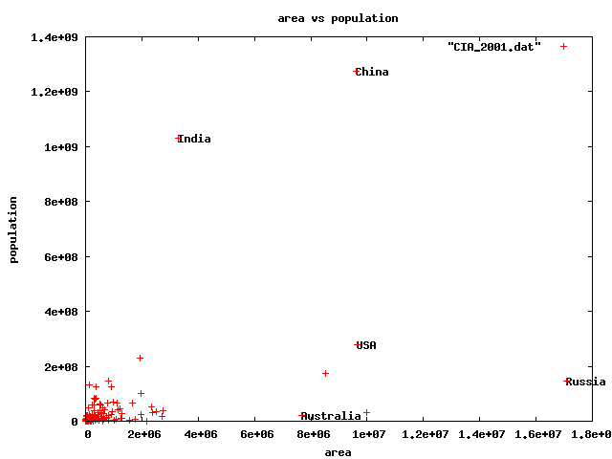




Q1) rules?

Slide 10
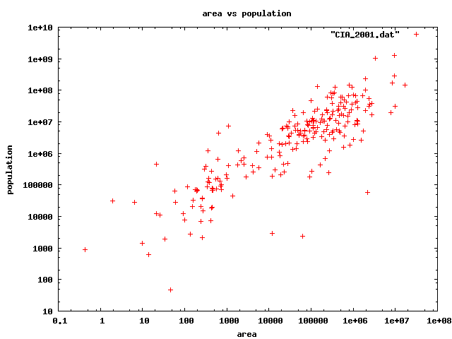
For fun: identification
Highest density
lowest density
47 residents(!)

Slide 11
Q1) rules?

Slide 12
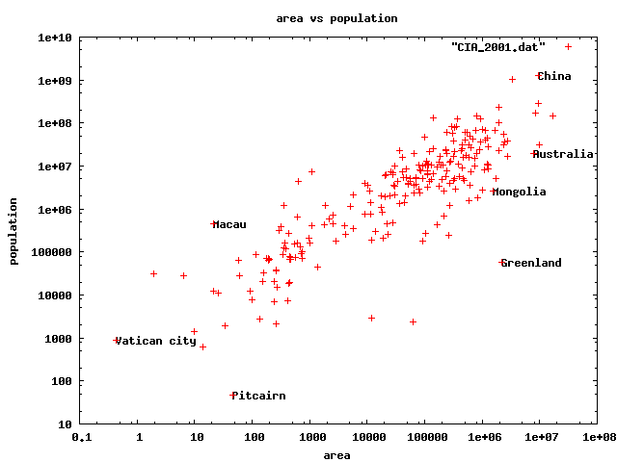
Q1) rules
47 residents(!)

Slide 13
Q1) rules?
47 residents(!)

Slide 14
Q1) definition
‘deviation from the common rule’
https://www.merriam-webster.com/dictionary/anomaly
Once we agree on the rules / axis-scales, outliers are better defined.
But: Who spots the rules?

Slide 15
Roadmap
Introduction – Motivation
Past
Present
Future
Q1) definition?
Q2) automation?
Q3) next steps?

Slide 16
Future – parting thoughts
Q1) Definition of anomaly?
A) “… strange/remote/unlikely, wrt our biases/priors”
Q2) can we automate it?
A) no, but: look for better models/biases/priors
Q3) next steps?
A) cross-disciplinarity -> new+better models

Slide 17
Q2) automation?
Q2.1
patterns
Q2.2
anomalies
compression
distance
density

Slide 18
Q2) automation?
Q2.1
patterns
Q2.2
anomalies
compression
distance
density

Slide 19
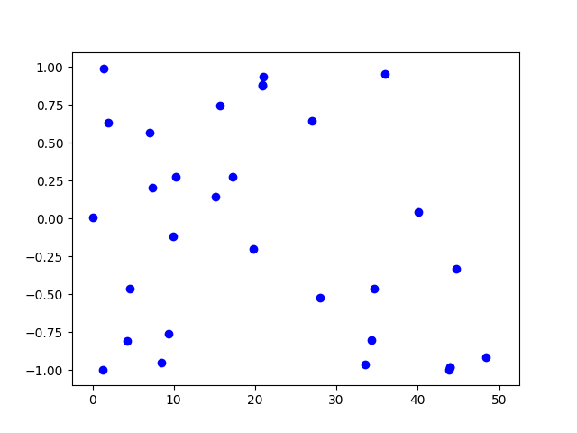
Q2.1) patterns <-> anomalies
Random?

Slide 20
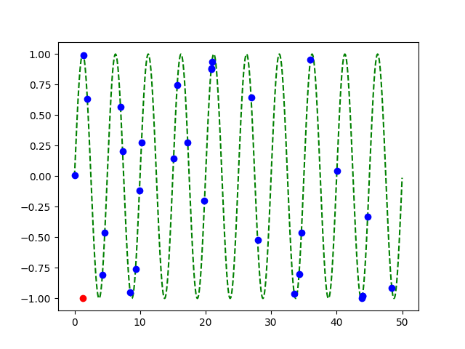
Q2.1) patterns <-> anomalies
Random?
Pattern!
+
Anomaly!

Slide 21
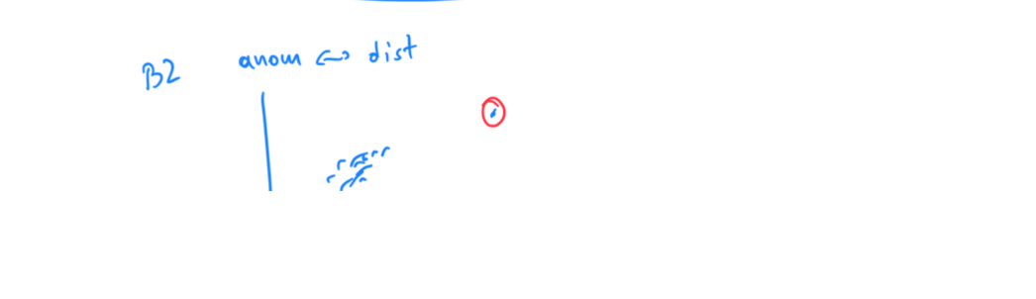

Slide 22
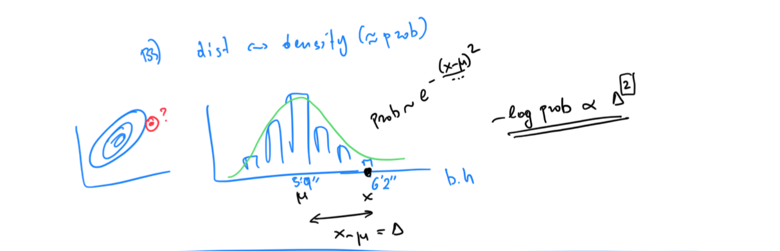

Slide 23
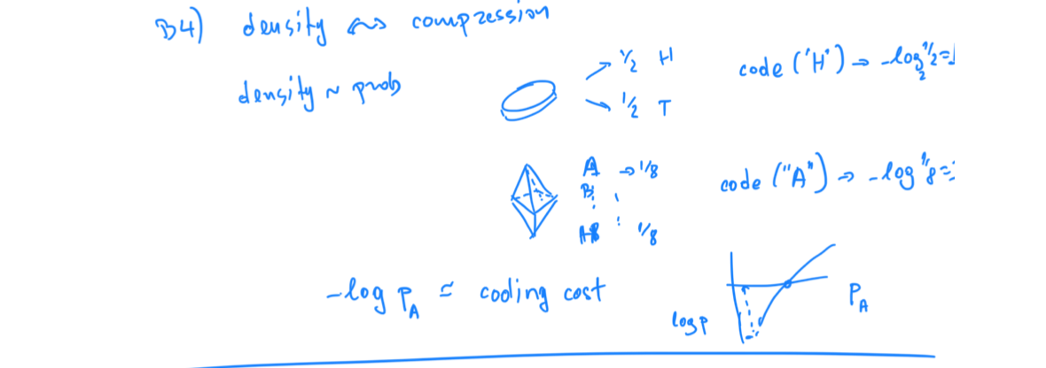

Slide 24
Q2) automation?
✓
Q2.1
patterns
Q2.2
anomalies
compression
distance
density

Slide 25
Q2.2) patterns <-> compression
2 int per point
1 int per point
(plus 3 parm’s of sinusoid,
plus 2 int for outlier)

Slide 26
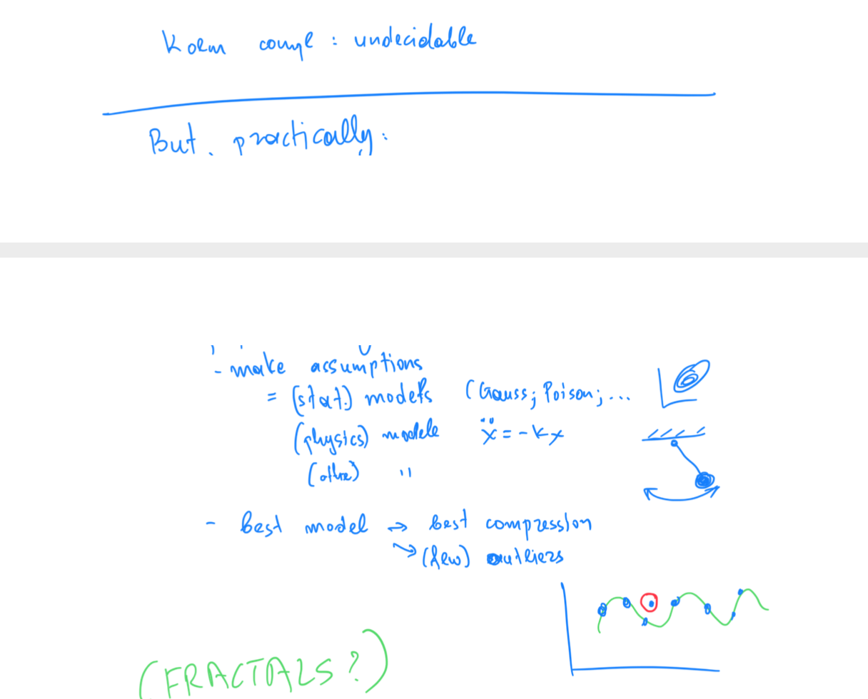

Slide 27
Roadmap
Introduction – Motivation
Past
Present
Future
Q1) definition?
Q2) automation?
Q3) next steps?

Slide 28
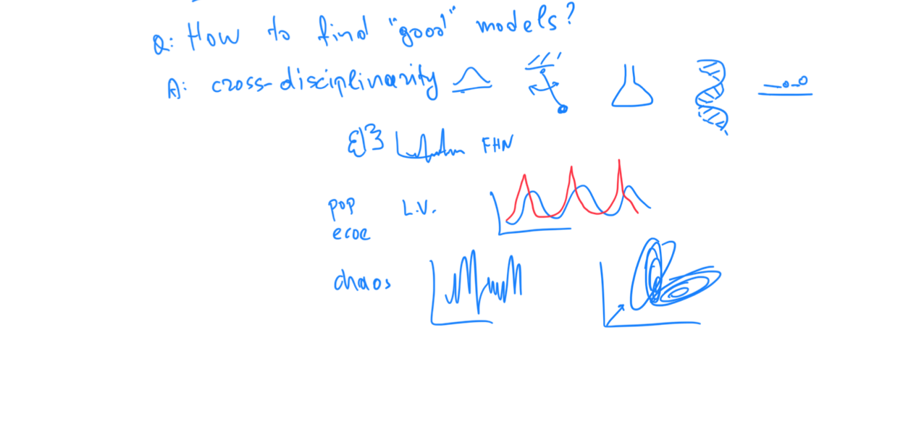

Slide 29
Examples of models
Fractals / self-similarity (Norway)
Logistic parabola (flies; covid)
Lotka-Volterra
Lorenz attractor (laser / synthetic )
Van der Pol / FitzHugh-Nagumo

Slide 30
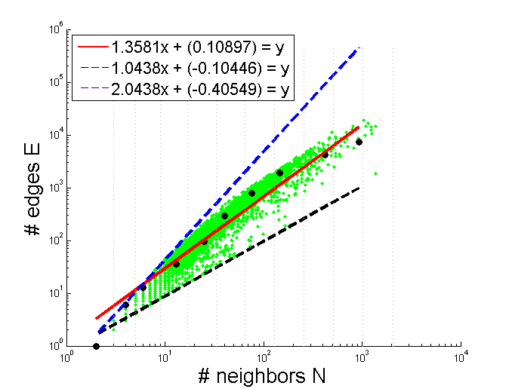

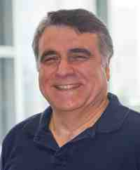
Thank you!

